Slide 1


EnergyForward Fleet Transition
Minnesota Power
2014 AAPT Summer Meeting
July 28, 2014
David J. McMillan,
Executive Vice President

Slide 2


Power Industry in Transformation
Shale Gas Supply
Transforming Long-Term Outlooks
Gas-Electric Market Alignment
Technology Enablers
Fuel Supplies
Abundant natural gas
Renewable accessibility
Life cycle considerations
Expanding Footprint
New Products
Renewables Expansion
Technology Evolution
MISO
Regional Energy
Market
EPA
Regulatory
Change
Low regional market prices
Transmission growth
Market sophistication
Mercury and Air Toxics Standard Final
Carbon Regulation Unfolding
Ongoing uncertainty

Slide 3
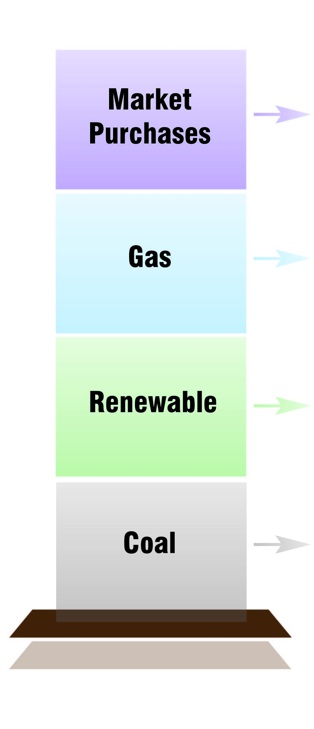
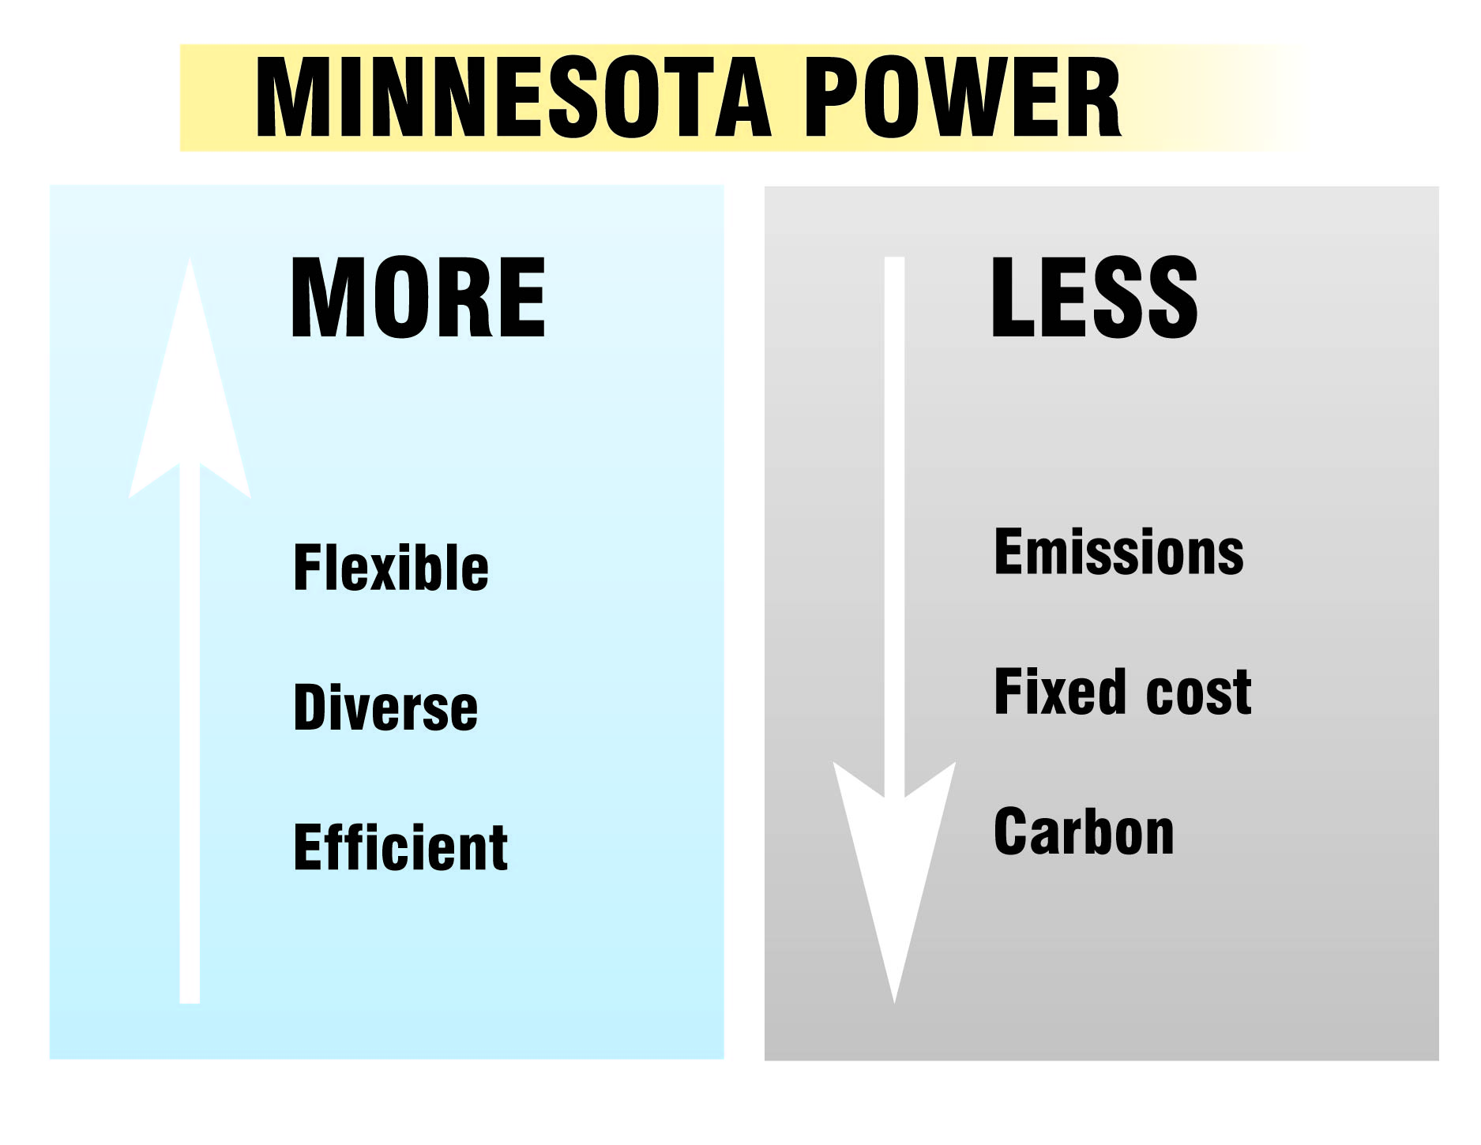


MP’s Fleet Transition Goals

Slide 4







and MP’s Customers
Large industrial impacts on MP:
  Significantly influence MP’s system needs
  Strongly reinforce a focus on cost in balance with stewardship and reliability
  Have led to innovative thinking and action about energy supply and partnerships for years
  Cost based rate issues for industrial customers are real
Regulated Utility MWH Sales

Slide 5
Resource Transformation
2005
2013
Current Long Term Planning Line Up
Long Term Direction:
1/3 renewable, 1/3 coal, 1/3 natural gas
This is an aspirational goal and we are well on our way to it

Slide 6

Manitoba Hydro Purchase
Manitoba Hydro is constructing:
695MW Keeyask Hydro Project (by 2019 ~ $6.5 billion)
1485MW Conawapa Hydro Project (as early as 2026 ~ $10.7 billion)
BiPole III HVDC Reliability Project - $3.3 B
Minnesota Power and Manitoba Hydro
are constructing:
500 kV Great Northern Transmission Line (GNTL) transmission line to deliver hydro to upper Midwest from north of Winnipeg to the Iron Range (by 2020)
  ~ $0.35 billion in Manitoba
  ~ $0.5-$0.65 billion in Minnesota
Will enable ~ 900MW hydro export to US
250 MW purchased for MP retail customers

Slide 7

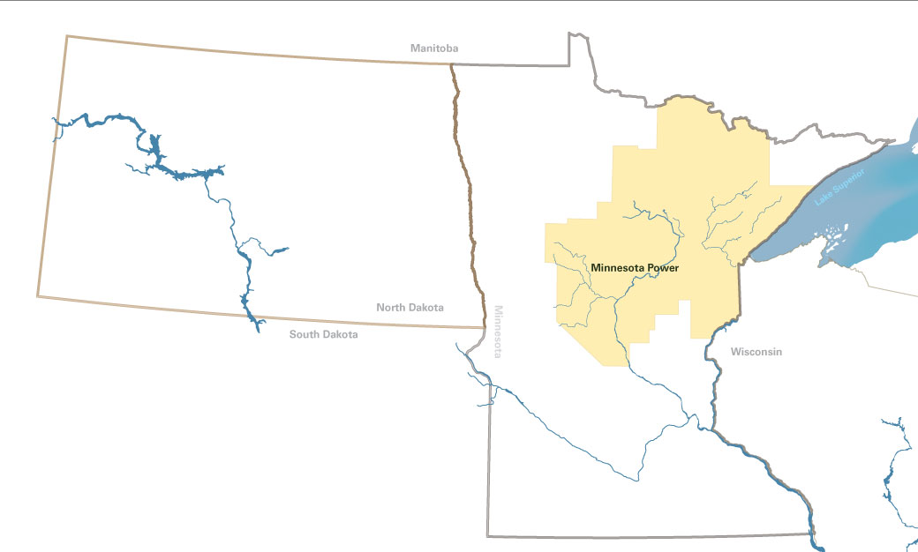
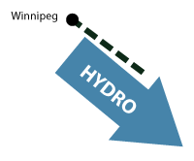
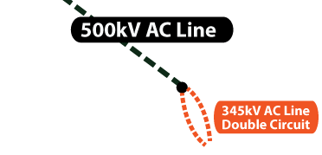
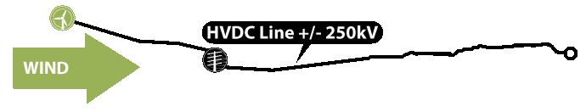
Creative/Regional Solutions
High volume, reasonable cost renewables secured
Wind to hydro storage enabled
Regional reliability and energy markets enhanced through added transmission
Manitoba
Hydro
250MW MP Purchase
Winnipeg
Minnesota Power
500MW MP Bison Wind
7

Slide 8
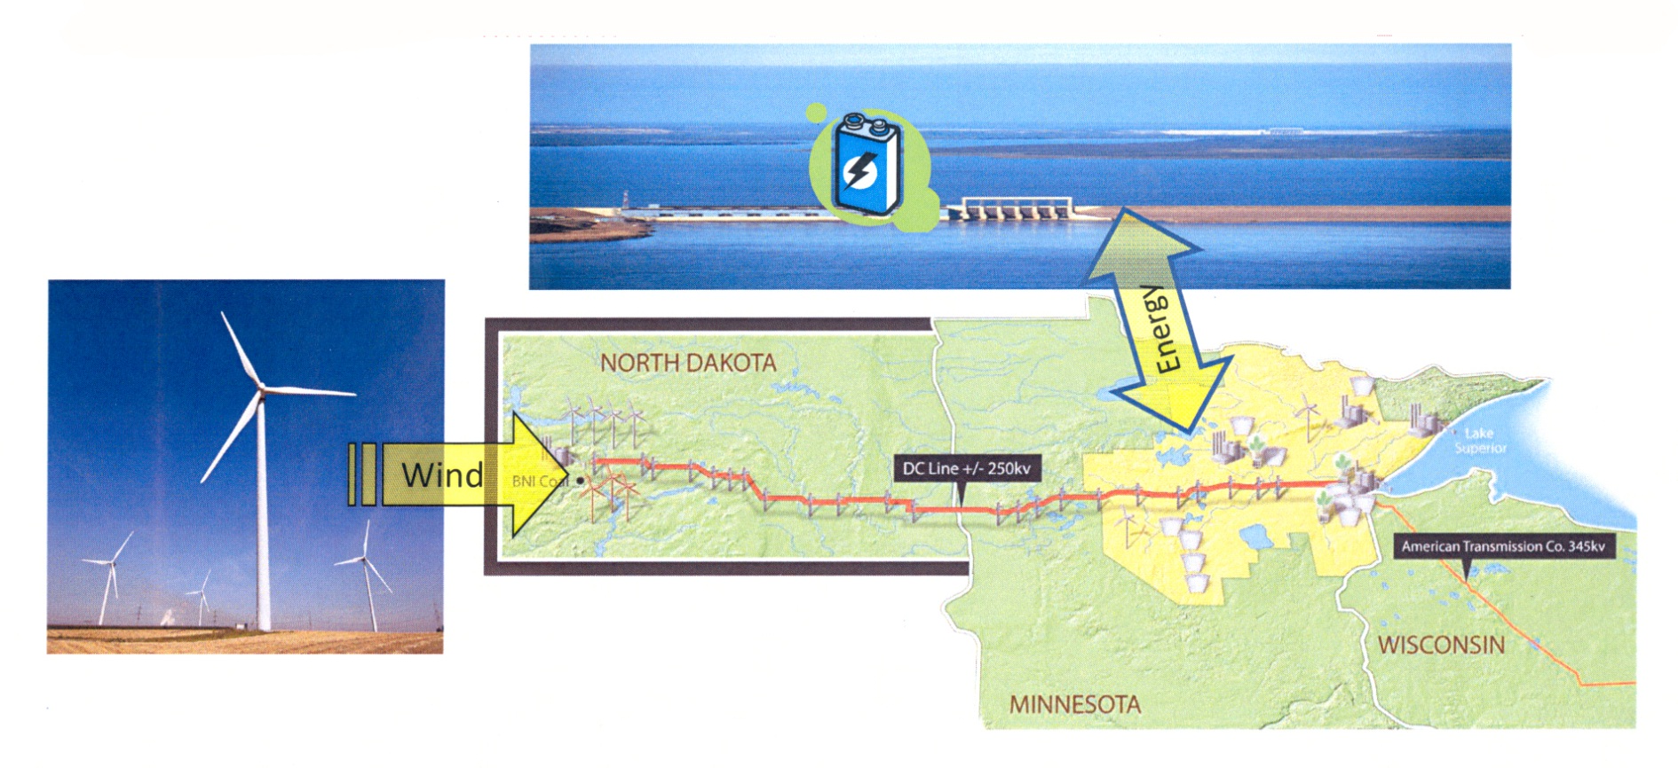
Wind / Hydro Synergy
“Excess” wind energy from MP Bison system in North Dakota able to be stored in MH’s system.
GNTL facilitates “storage of wind energy.”
MH and MP systems operate independently; i.e., typically dollars not MWhs exchanged.
Notes:
8
8

Slide 9

Delivering Energy Savings
MP Conservation Results Exceed Goal!
MN Conservation Goal of 1.5%

Slide 10
Proposed EPA Carbon Rule Issues
Rule appears to discount or ignore “early” actions taken between 2005-2012 (renewables, plant efficiency, conservation, etc.)
Cross-border ownership not recognized (e.g., ND wind serving MN customers)
As a result of the first two bullets, Minnesota is asked to do more than its share
Forced fuel switching will affect power markets
Forced coal to gas switch brings price volatility and reliability risk
  Base NGCC capacity and energy production assumptions questionable
Uncertainty calculating reduction goals and crediting action

Slide 11

Thank You!
Notes:
11
11

